Slide 1
Mozart: The Voice of God
Lesson emphasizing Writing-to-Learn strategies, with application for multiple Writing-to-Demonstrate-Learning pieces that are suitable for students’ writing portfolios. John Brown

Slide 2
Essential Questions
Who are the most famous Germans in history?
Who would Mozart be in contemporary society?
How can we compare the music of the big three composers?
How does the portrayal of Mozart in Amadeus contribute to the film’s themes?

Slide 3
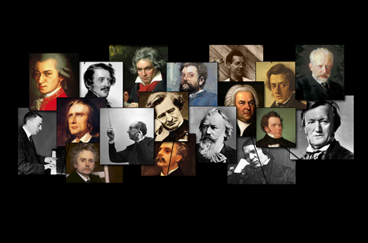
Brainstorm: Name as many classical composers as you can. Who is German?

Slide 4
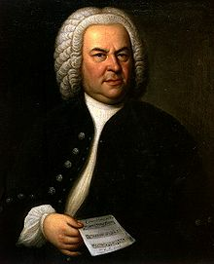
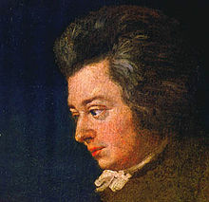
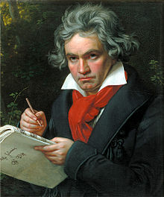
Pillars of the Faith: Who’s Who?

Slide 5
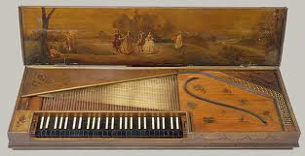
Clavichord

Slide 6
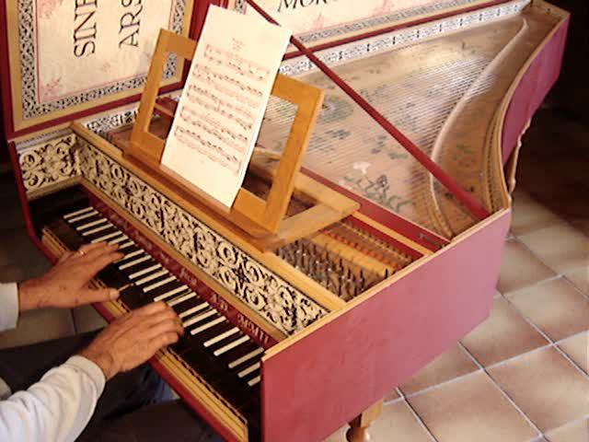
Harpsichord

Slide 7
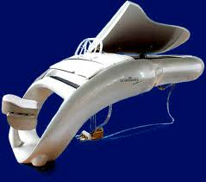
Modern Grand Piano

Slide 8
German words for Music (cognates)
die Musik
das Klavier
die Gitarre
die Violine, Geige
das Konzert
Kappelmeister
die Symphonie (unusual)
die Oper
der Komponist(in)
komponieren
der Direktor

Slide 9
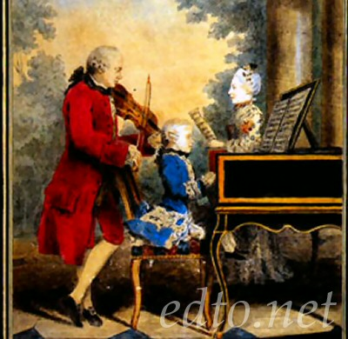
What do you feel (mood), think & see (images, ideas, places, circumstances)? http://www.youtube.com/watch?v=X7jEps gpPLQ

Slide 10
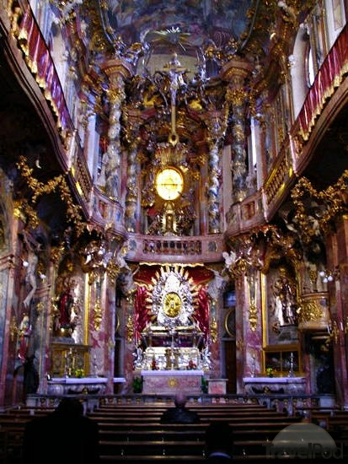

Slide 11
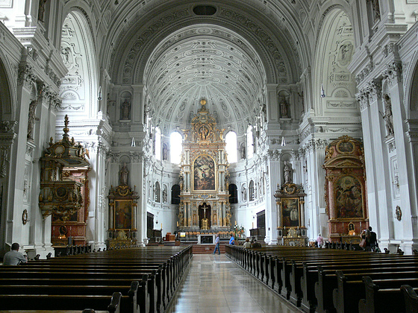

Slide 12
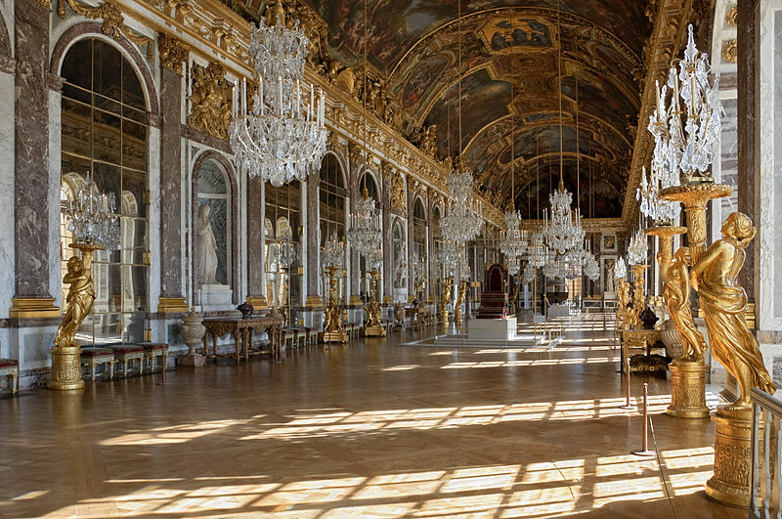

Slide 13
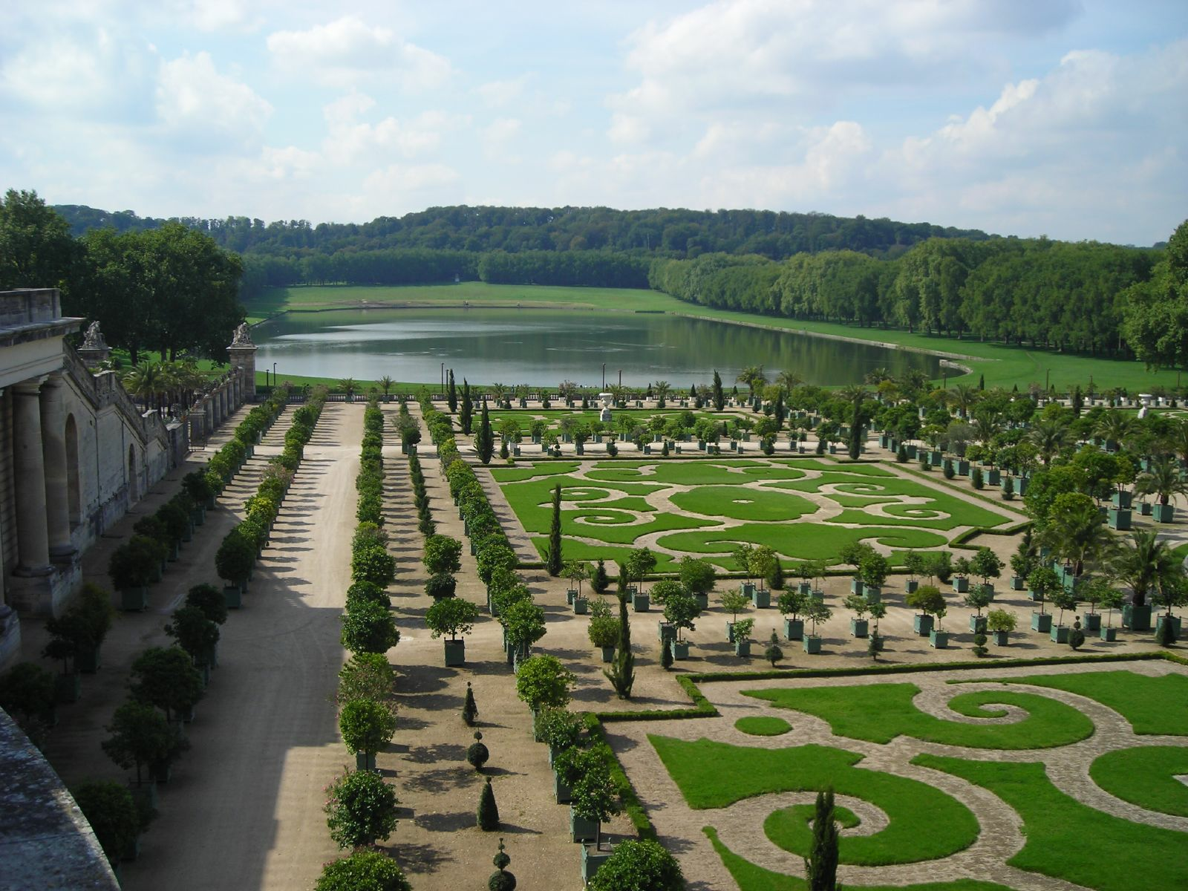

Slide 14
Baroque vs. Classical Characteristics (Period, Epoch, Era)
Illusion of motion
Off-center
Order in universe
More Divine
Dark
bizarre, exuberant
Appeal to senses
Energy, divine power
Church music
Fixed
Symmetrical
Order in universe
More Humanistic
Light
Enlightening
Appeal to mind
Mind, human intellect
Court music

Slide 15
K-W-L: Inquiring Minds Want to Know
Full Name
Birth time
where born, lived
anything about family
rich or poor, success or failure in lifetime
historical events during lifetime
physical features
personality & character
life span
Contemporaries, predecessors, students
musical compositions
types of compositions
number of compositions
religion
Why might he be interesting enough to make a movie about?

Slide 16
Jigsaw http://www.studio-mozart.com/mozart/index.htm
Group 1: 1) Name, 2) Birth, 3) Where lived, 4) Family, 5) Wealth/Success, 6) Health
Group 2: 1) Contemporary Events, 2) Contemporary People, 3) Predecessor, 4) Successor/Students, 5) Compositions
Group 3: 1) Physical Features, 2) Personality/Character, 3) Religion/Belief/Ideals, 4) Why might Mozart be fodder for film?

Slide 17
Return to K-W-L & Ask the Expert
On your K-W-L sheet, write what you have learned, in response to what you wanted to know and what seems important or interesting. Write 5-7 items.
Then write three more things about Mozart that you want to know.
You will take turns asking me what you want to know, and I will do my best to answer. Write what you learn.

Slide 18
Child Prodigy
What do you consider the personality and character of “pure” genius to be like? Write down a few quick thoughts.
Why might the idea of “pure” genius make an interesting movie? What big ideas might a writer/director get at? Write down a few quick thoughts.
Writing Prompt: If Mozart were born today, what would his character, music, and career be like? Support your answers.
Falco, Rock Me Amadeus: http://www.youtube.com/watch?v=cVikZ8Oe_XA

